Slide 1
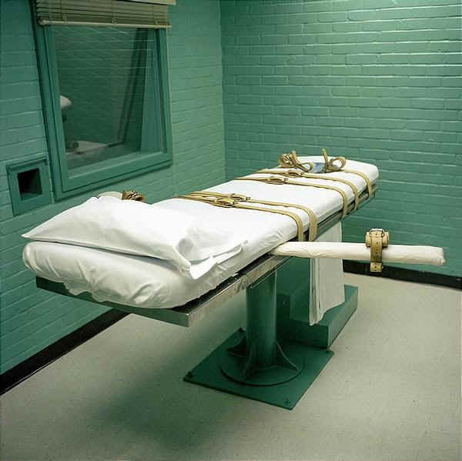
Capital Punishment
A picture of the lethal injection chamber at Huntsville State Penitentiary in Huntsville, TX

Slide 2
Thinking About Capital Punishment
The death penalty is legal in certain states but illegal in others. How many states out of 50 do you believe have the death penalty as a form of punishment?
33 have it and 17 do not. (Alaska, Hawaii, almost all of NE, and most recently NY and CT have abolished it)
Voluntary moratorium from 1967-1972. From 1972-1976 it was mandatory. In 1977, we resume executions in the US.
Should deciding who receives the death penalty be left up to a judge or a jury?
If your life is on the line to be executed, should the court consider any circumstances which should “spare your life” from execution? If so, what could they be?
Mental capacity, abused as a child
Bonus Question: When was the last year that PA executed a prisoner?
Since 1976, we have executed 3. 216 sit on death row. Two in 1995 and the last in 1999. All received lethal injection, all waived appeals, and asked that the executions be carried out.

Slide 4
Capital Punishment
Also known as the death penalty
1) most controversial sentence given to defendants
2) 1st Execution in the US: 1630 by hanging
3) mainly used as a punishment for 1st degree homicide
Nathan Hale (above) about to be hanged as a spy by the British army during the Revolutionary War

Slide 5
Legality of Capital Punishment
In 1972, the case of Furman v. Georgia, the Supreme Court stated in a 5-4 decision that death penalty violated the 8th amendment and was therefore unconstitutional
4 years later the Court overturned their previous decision in the case of Gregg v. Georgia (7-2 decision)
As a result, the states were allowed to decide for themselves if they would or would not allow capital punishment
Justice Potter Stewart (above) wrote the majority opinion in the Gregg case that officially overturned the Furman decision

Slide 6
Numbers Behind Capital Punishment
Inmates & Methods
1) 44% are Caucasian
2) 12% are Hispanic
3) 41% are African-American
4) there are currently 51 female prisoners on death row in the US
Scott Peterson (above), convicted and sentenced to death in 2005, currently sits on death row at San Quentin Prison in California

Slide 7
Numbers (cont’d)
At the current time, 33 states allow for capital punishment (including PA)
1. all states must have lethal injection as the primary option
2. Some states have secondary methods:
A. Electrocution (9 states allow)
B. Gas Chamber (4 states allow)
C. Hanging (3 states allow)
D. Firing Squad (3 states allow)
Ronnie Lee Gardner (above) was the most recent prisoner in the US to be executed by firing squad (6/18/2010 in Utah). He was sentenced in 1985. Killed a man in a robbery, then on the way to a hearing for that homicide, he shot/killed an attorney.

Slide 8
Determining Who Receives Capital Punishment
Requires a two-part trial
Part 1 – jury decides guilt or innocence
Part 2 – same jury decides if death should be the penalty

Slide 9
Determining Who (cont’d)
Juries are required to compare aggravating and mitigating circumstances in determining Capital Punishment
1) aggravating – factors that suggest a more severe punishment is appropriate (based on the cruelty of the crime)
2) mitigating – factors that suggest a less severe punishment (defendant was abused, defendant has no prior record, or age of defendant)

